Slide 1
Chain of Custody
Digital Forensics And Incident Response
Forensic Examination of an NTFS E01 Evidence Image
Using Autopsy / Sleuth Kit
Evidence Integrity • File Metadata • Hash Analysis • MFT Analysis
BY RIDHI JAIN
1

Slide 2
Project Objective
Analyze a forensic NTFS E01 evidence image in a controlled environment.
Preserve and document evidence integrity using cryptographic hashes.
Identify relevant files and examine their metadata and timestamps.
Analyze NTFS MFT information using Sleuth Kit / istat.
Document forensic observations for a Chain of Custody investigation.
2

Slide 3
Tools & Environment
Autopsy — forensic case management and evidence analysis
The Sleuth Kit (TSK) — filesystem and low-level forensic analysis
istat — NTFS MFT entry and metadata examination
PowerShell — cryptographic hash calculation
Evidence Image — NTFS E01 forensic image (ntfs1-gen1.E01)
3

Slide 4
Forensic Investigation Workflow
1. Load E01 evidence image
2. Examine filesystem and allocated files
3. Identify relevant PDF/JPG files
4. Select report02-3.pdf for detailed analysis
5. Capture file metadata and cryptographic hashes
6. Examine NTFS MFT using istat
7. Record findings and preserve evidence details
4

Slide 5
Evidence Integrity & Hash Analysis
Evidence image was examined as a forensic E01 image.
SHA-256 hashing was used to document evidence integrity.
MD5 and SHA-256 values were also recorded for the selected file.
Cryptographic hashes provide a reproducible fingerprint for comparison.
The selected file's Hash Lookup Result was reported as UNKNOWN.
report02-3.pdf | SHA-256: b2e4edc829344f91d3b1d50eacd8e2aece6432c104a8d6a3ab86ff7afa57b0a0
5

Slide 6
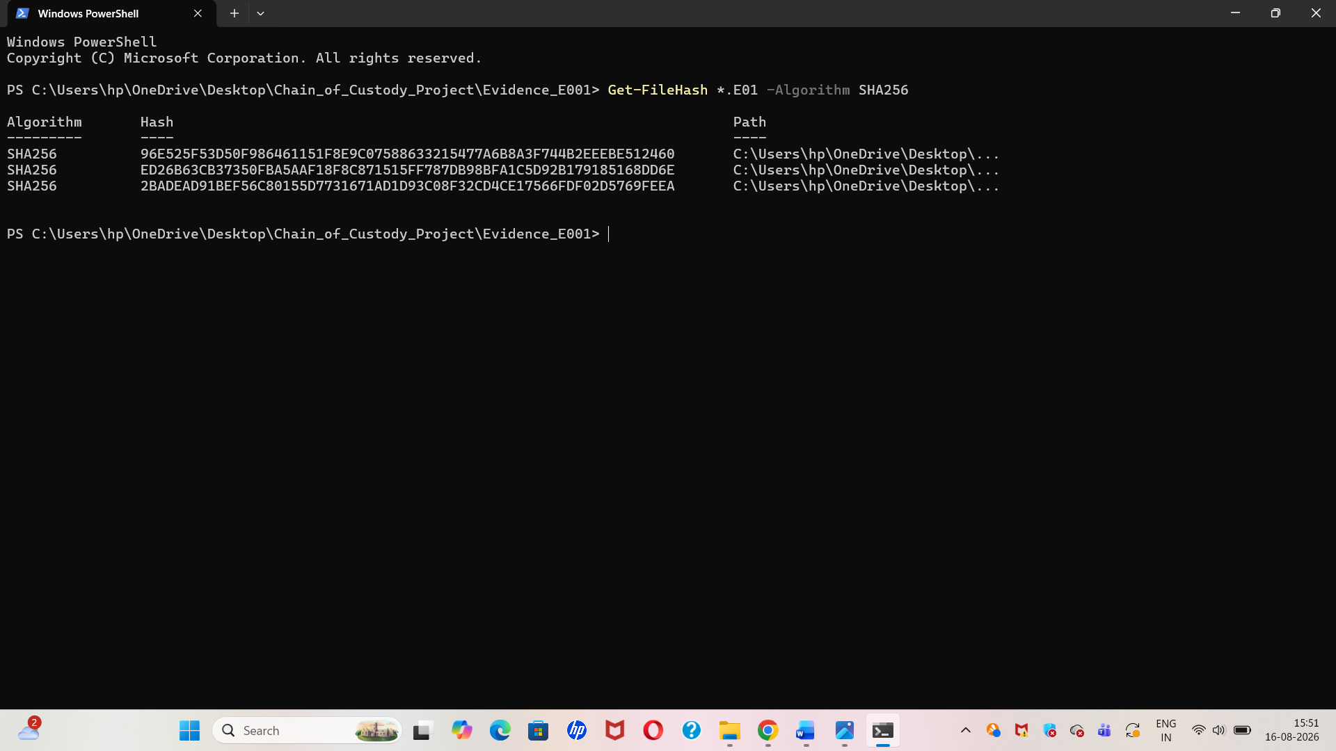
E01 Evidence Image and Hash Verification
This step involved verifying the acquired E01 forensic evidence image and recording its cryptographic hash value.
The hash was used to maintain evidence integrity and ensure that the forensic image remained unchanged during the investigation.

Slide 7
File Metadata Analysis — report02-3.pdf
File Type: File System
MIME Type: application/pdf
Size: 1,421,998 bytes
Allocation: File Name Allocated; Metadata Allocated
Modified: 2009-01-01 04:38:33 IST
Accessed: 2009-01-01 04:39:38 IST
Created: 2009-01-01 04:39:38 IST
MD5: dede94f84fb2d00dc93ed00fda272a18
6

Slide 8
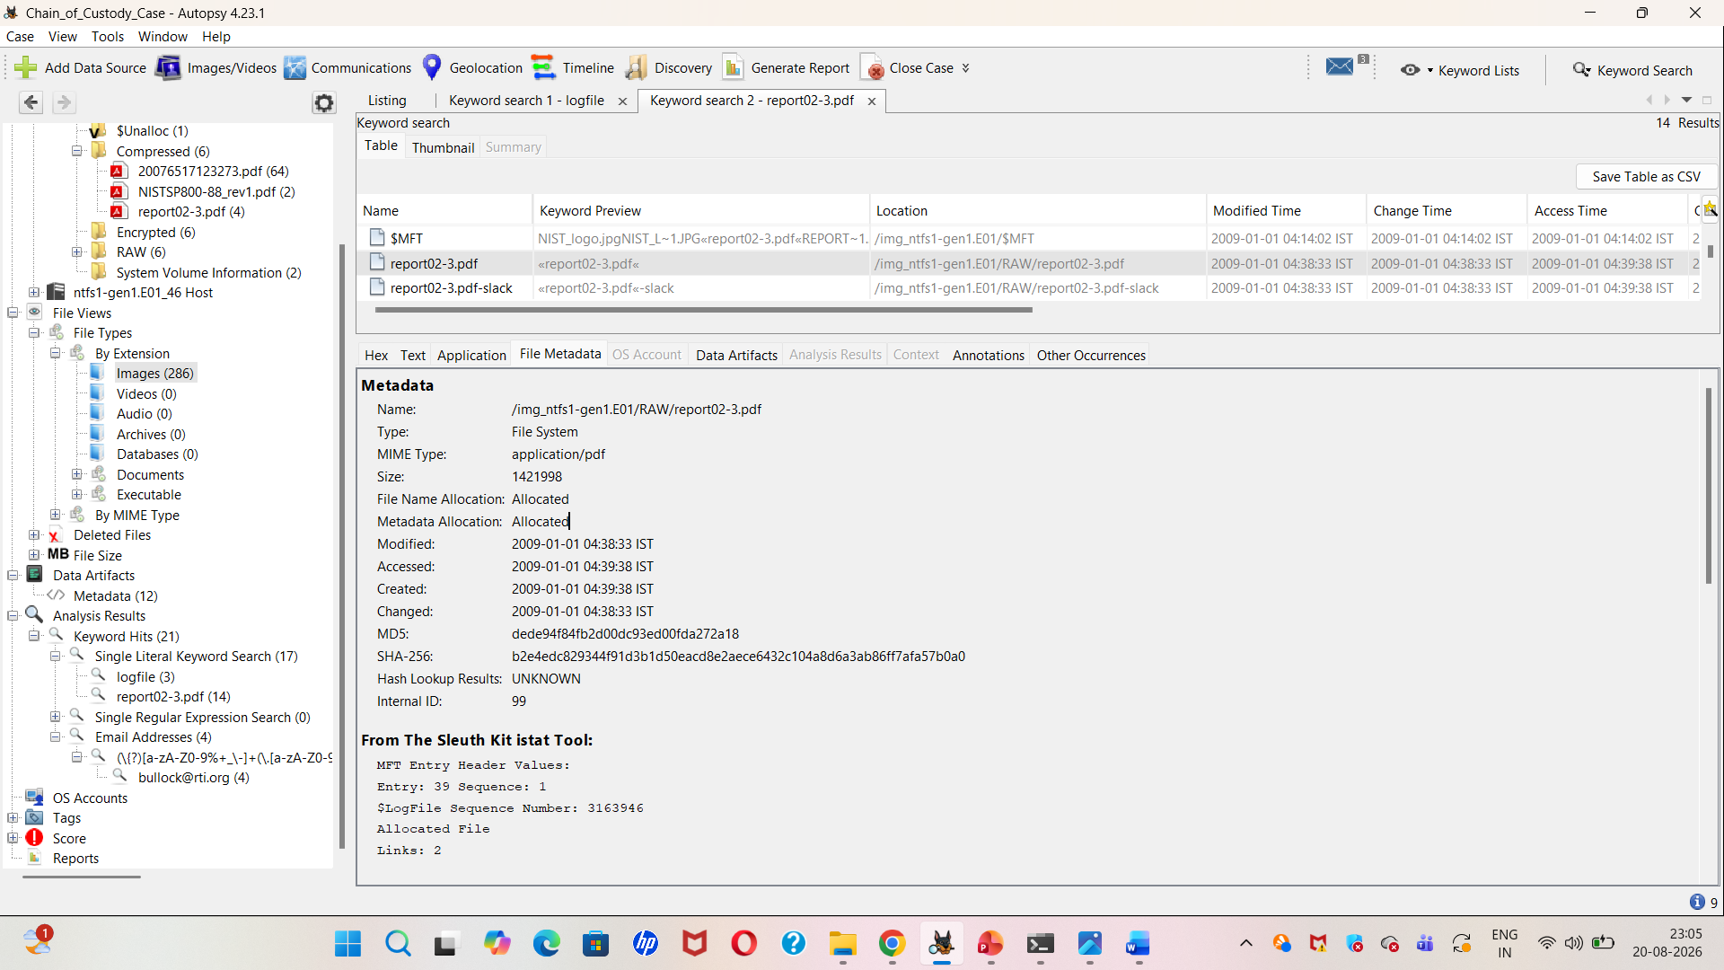
File Metadata Analysis of report02-3.pdf
Autopsy was used to examine the metadata of the identified PDF file, including its size, file type, timestamps, MD5 and SHA-256 hash values.
These details helped document the file characteristics and supported the forensic analysis of the evidence.

Slide 9
NTFS MFT / istat Analysis
MFT Entry: 39 | Sequence: 1 | Allocated File
Links: 2 | Parent MFT Entry: 27 | Sequence: 1
$STANDARD_INFORMATION and $FILE_NAME attributes were identified.
Created: 2009-01-01 04:39:38.449875 IST
File Modified: 2009-01-01 04:38:33.000000 IST
Accessed: 2009-01-01 04:39:38.465500 IST
$DATA attribute: Non-Resident; size 1,421,998 bytes
7

Slide 10
NTFS MFT and istat Analysis
The Sleuth Kit istat tool was used to examine the NTFS Master File Table (MFT) entry associated with report02-3.pdf.
The analysis provided information about file allocation, timestamps, MFT attributes, parent MFT entry and data attributes.

Slide 11
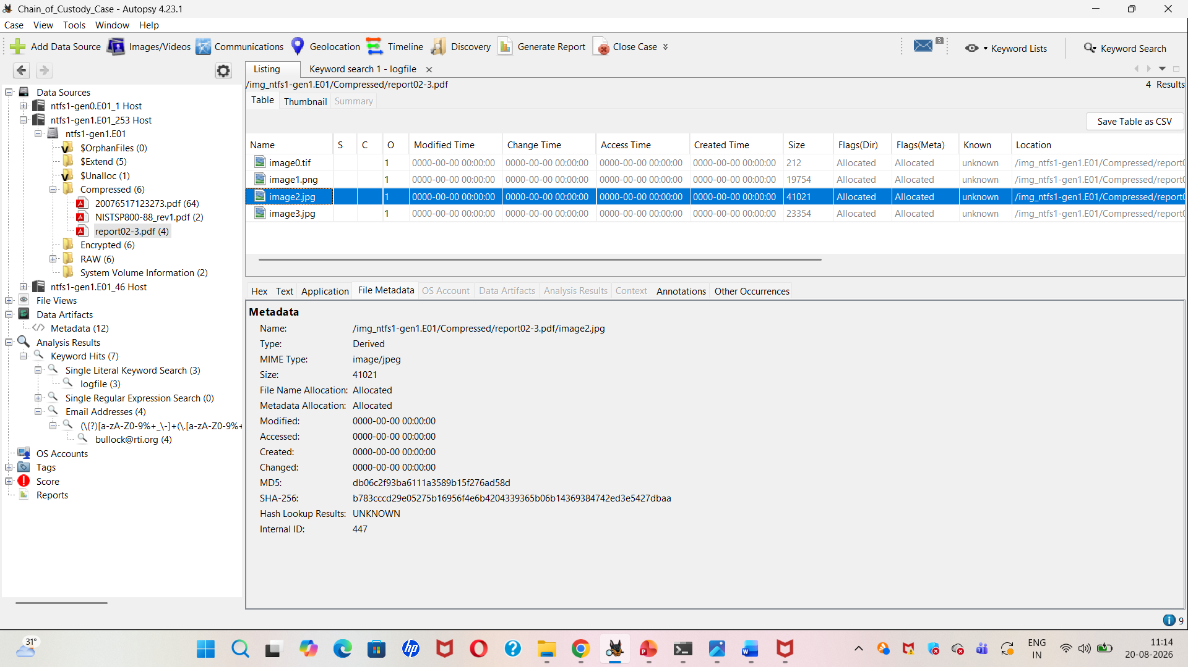
Examination of Recovered Evidence Files in Autopsy
Autopsy was used to examine and review the files recovered from the E01 forensic image.
The file listing shows multiple recovered artifacts, including PDF and image files, which were examined as part of the digital forensic investigation.

Slide 12
Findings & Observations
The selected PDF was successfully identified within the forensic image.
The file was allocated and had associated NTFS metadata.
Multiple timestamps were available from both Autopsy metadata and MFT attributes.
MD5 and SHA-256 values were successfully recorded.
The PDF preview did not render readable document content in the viewer.
Therefore, conclusions are based on forensic metadata and filesystem evidence rather than the visible PDF content.
8

Slide 13
Conclusion
The investigation demonstrated a structured forensic workflow for an NTFS E01 image.
Autopsy and Sleuth Kit provided complementary filesystem and metadata analysis.
Hash values, timestamps, file allocation status and MFT attributes were documented.
The analysis supports evidence integrity and traceability within the project scope.
The findings can be used as documented forensic observations for the Chain of Custody report.
9

Slide 14
References
Autopsy Digital Forensics Platform
The Sleuth Kit (TSK) documentation
NIST — Computer Security / Digital Forensics guidance
SWGDE — Best Practices for Digital Evidence
Digital Corpora — Forensic Disk Images and Datasets
11

Slide 15


